Slide 1

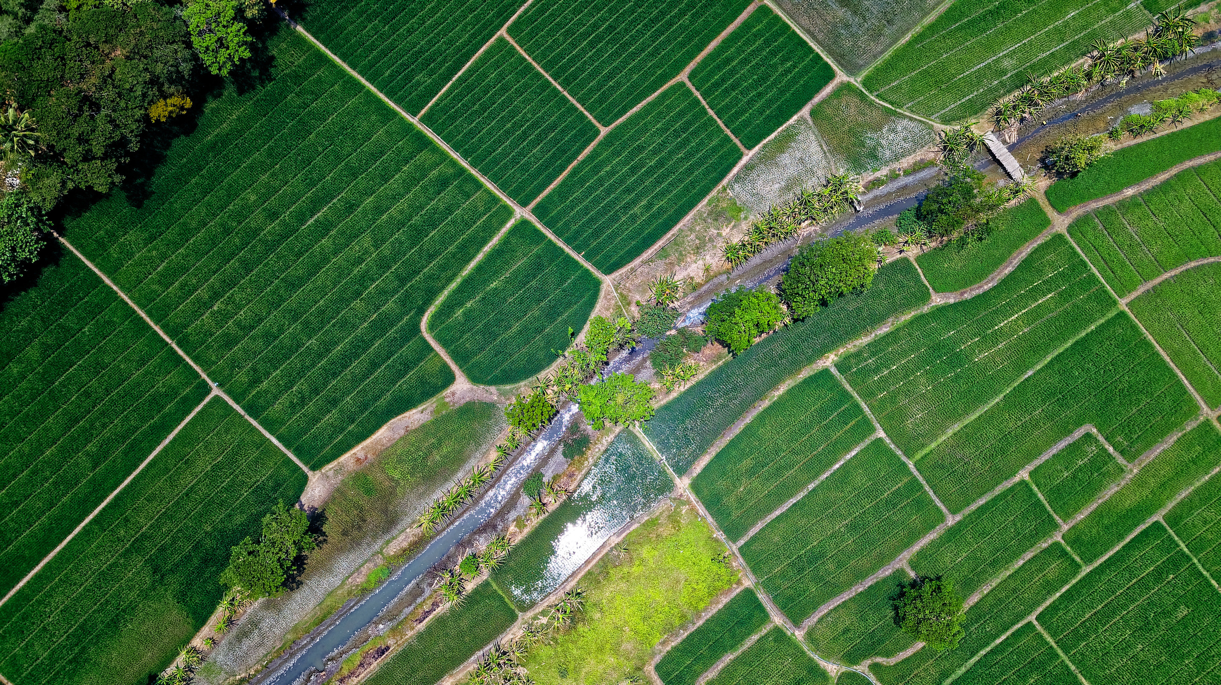



LARANA AGRIFARM
HOME
ABOUT
SERVICES
Multi
Crop
recommendation
accuracy and predictive analysis based on
Machine Learning Algorithms
Revolutionizing Modern Agriculture
Yeameen Aziz Abdullah 21-44886-2
Wasee Ahsan 21-44892-2
Jannat Ara Tasnim 21-45667-3
Nabiha Tahsin 21-45685-3
NEXT >

Slide 2






Introduction
What means Multi crop recommendation ?
A process of optional crop recommendation to grow in a definite geographical field based on some soil based and meteorological parameters.

Slide 3
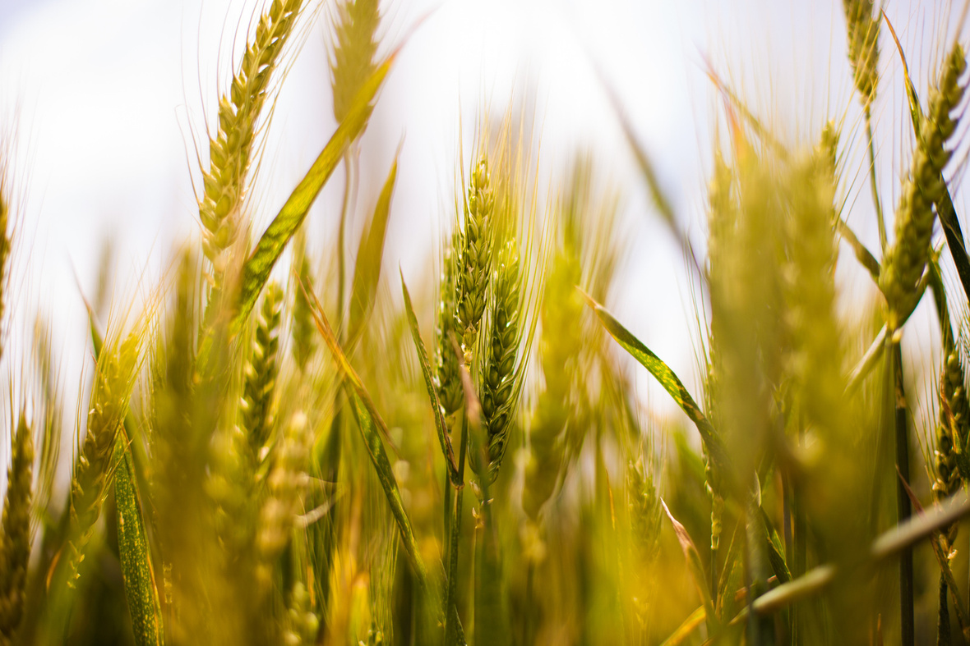


Challenges in Traditional Farming
Decreasing arable land
Low yields due to outdated methods
Weather and Climate Changes
Soil Fertility Degradation
Post-Harvest Losses

Slide 4

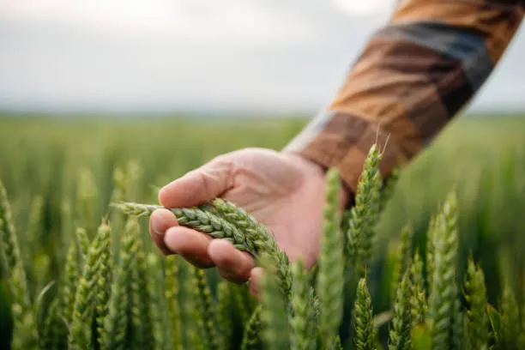
Objective
Main goals of this study :
Can help farmers in achieving maximum production and sustainability.
Guide the selection of crops that are appropriate for the present environmental and soil conditions.
Notes:
3

Slide 5
Workflow
Confidence and probability testing for two crops with:
Best result achieved with XGBoost Classifier
Dataset collection
ROC Curve Generated
for XGBoost Classifier
Correlation Heatmap generate
Logistic
Regression
Random
Forest
Limitations & future work analysis
CATBoost
XGBoost

Slide 6

Detailed Steps for Crop Prediction Analysis
Data Loading: Imported libraries and loaded the dataset Crop_recommendation.csv.
Preprocessing: Features (X) and target (y) separated; Target labels encoded using LabelEncoder, data visualized in a correlation heatmap generated.
Train-Test Split: Split data into 80% training and 20% testing sets.
Model Training: Random Forest, XGBClassifier, CatBoostClassifier, LogisticRegression .
Prediction and Confidence: Predicted crops and calculated class probabilities using predict_proba.
Second-Best Crop Logic: Excluded the first-best crop to retrain and identify the second-best crop with confidence.
Evaluation: Displayed top two crop recommendations with confidence for 440 samples and calculated model accuracy and saved in crop_predictions.csv file.

Slide 7
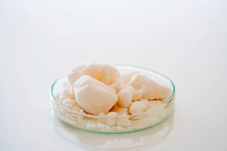
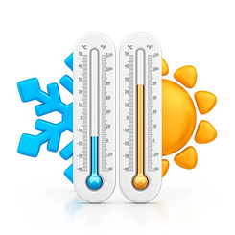
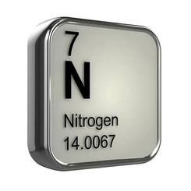
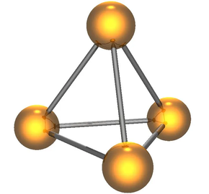
About Dataset
Crop_recommendation.csv
Supervised Dataset
Imported from Kaggle
8 attributes and 2201 instances
Preprocessed dataset
no missing values apparent
Attributes:
N - ratio of Nitrogen content in soil
P - ratio of Phosphorous content in soil
K - ratio of Potassium content in soil
pH - pH value of soil
also included humidity , temperature and Rainfall and
Label as target attribute

Slide 8
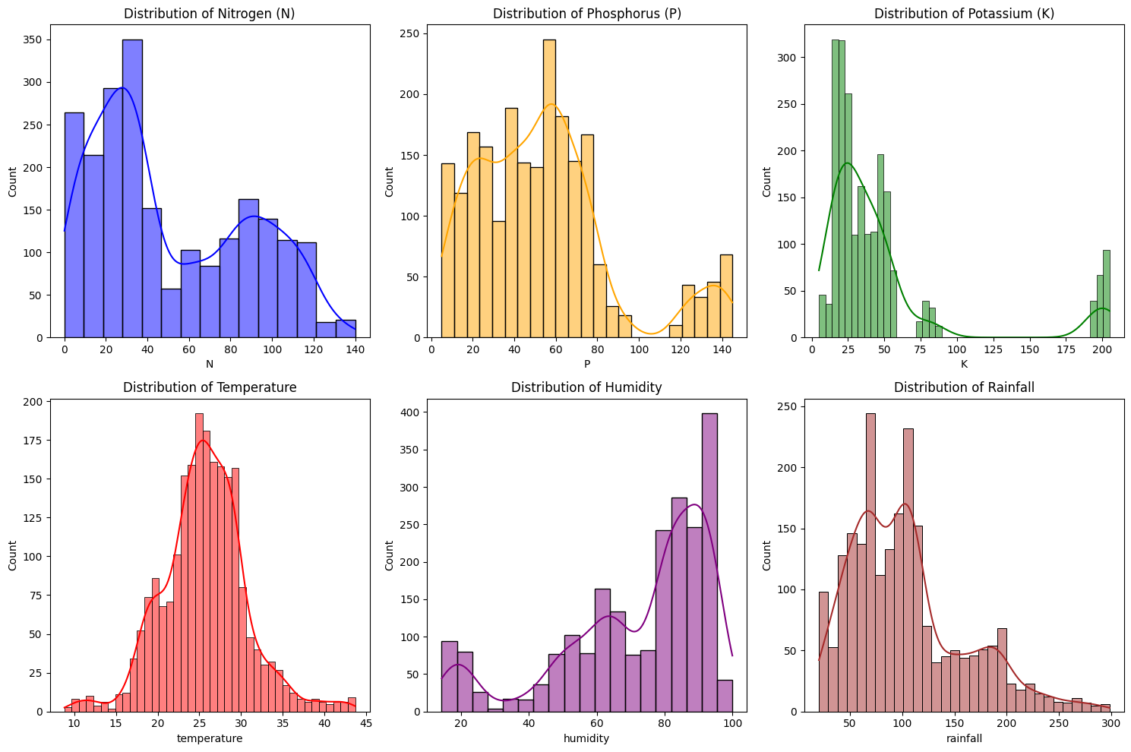
About Dataset
Variable Distribution in Data Visualization

Slide 9
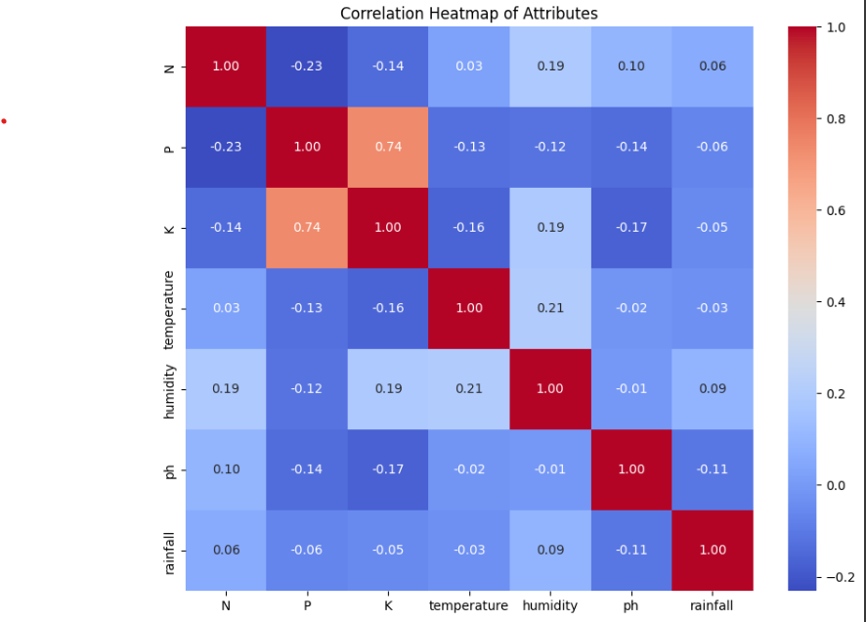
Correlation Heatmap
The diagonal line of cells- correlation of a attribute with itself.
The more darker color of blue- negative correlations with others.
The one with lighter- positive correlation
For example- the correlation among rainfall and humidity is 0.09 which means positive correlation
Correlation heatmap help find the potential relationships among attributes and their strength.

Slide 10
Models Used
Logistic Regression: A supervised learning algorithm to predict the probability whether that instance belongs to a class or not analyzing the connection between two data factors.
Random Forest Classifier: Instead of making relationship between attributes, this learning technique makes predictions based on patterns in the data.
XGBoost Classifier: A powerful and efficient implementation of the boosting algorithm for supervised machine learning tasks that can help in better understanding of data and decision-making.
CATBoost Classifier: A machine learning gradient-boosting algorithm that's particularly effective for handling data sets with categorical features, in which, the data must be pre-processed.

Slide 11
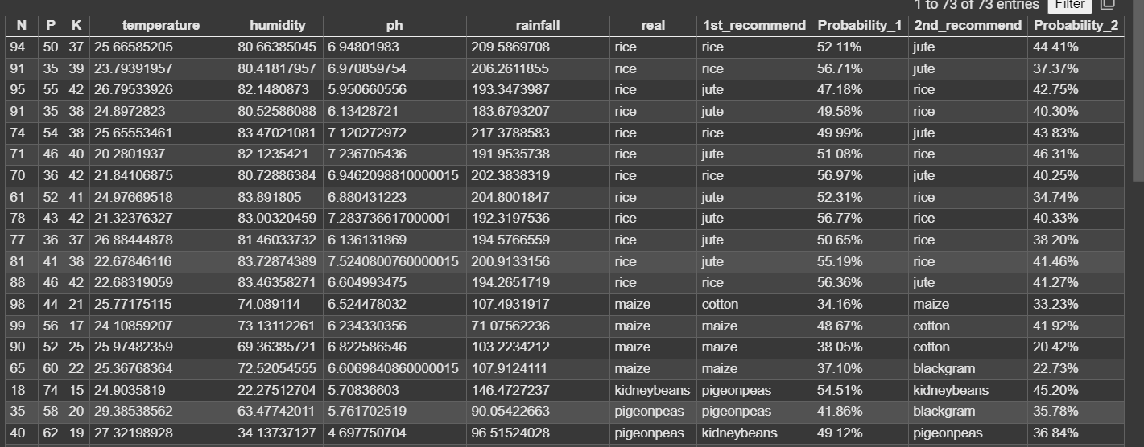
Model and Algorithm
USING LOGISTIC REGRESSION

Slide 12
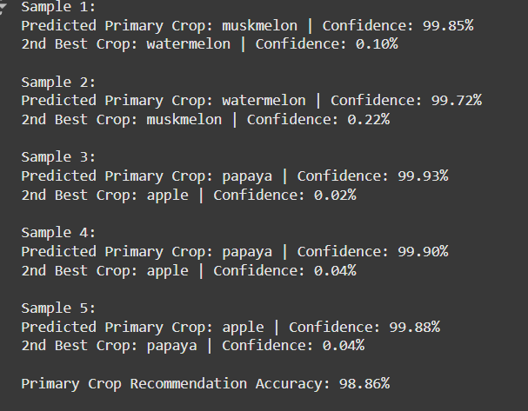
Model and Algorithm
CATBOOST CLASSIFIER
TOP 2 CROP RECOMMENDATION
ACCURACY CALCULATION
CONFIDENCE IN PREDICTIONS

Slide 13
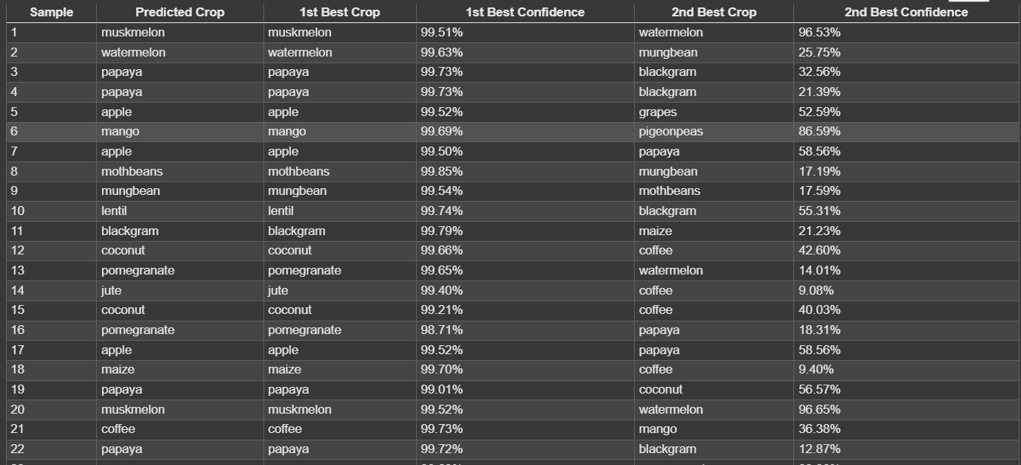
Model and Algorithm
XGBOOSTCLASSIFIER

Slide 14
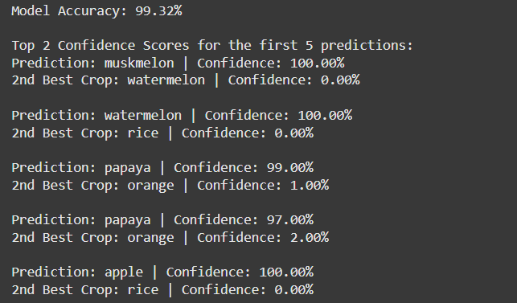
Model and Algorithm
Random Forest
TOP 2 CROP RECOMMENDATION
ACCURACY CALCULATION
CONFIDENCE IN PREDICTIONS

Slide 15
Model and Algorithm
Comparison of Algorithms for This Dataset :
Algorithm | Strengths | Weaknesses
Random Forest | Robust to overfitting, interpretable, handles non-linear data. | Slower with large datasets, less accurate than gradient boosting.
Logistic Regression | Fast interpretable, useful for linear relationship | Struggles with non-linear and complex relationships.
CATBoost Classifier | Handles numerical and categorical features well, less hyperparameter tuning required. | Slower training compared to Random Forest and Logistic Regression.
XGBoost | High accuracy, scalable, handles missing values, robust to overfitting. | Requires careful hyperparameter tuning, computationally expensive for large

Slide 16
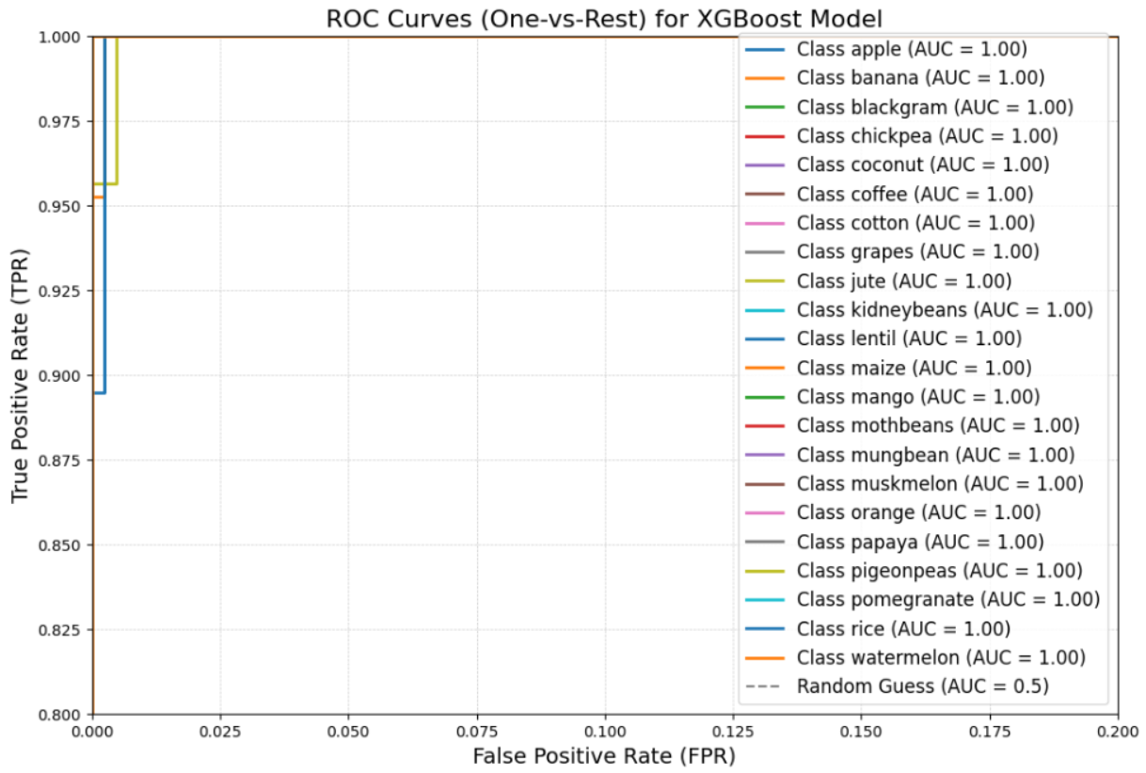
AUC-ROC Curve for XGBoost
performance of a XGBoost, using the one-vs-rest approach.
An AUC of 1.00 for all classes, indicating perfect classification.
Curves clustered at the top-left corner, indicating near-perfect performance.
One-vs-rest method ensuring the model reliably differentiate between crops based on input features.
This ROC curve confirms the model's reliability and performance in predicting crop classes.
The ROC curve shows the performance of a multi-class classification model, XGBoost, using the one-vs-rest approach. The model has an AUC of 1.00 for all classes, indicating perfect classification. The curves are clustered at the top-left corner, indicating near-perfect performance. The one-vs-rest method ensures the model can reliably differentiate between crops based on input features. This ROC curve confirms the model's reliability and performance in predicting crop classes.

Slide 17
Why XGBoost instead of other models
XGBoost Classifier is an excellent choice due to ability to handle non-linear interactions, scalability, and granular tuning for multi crop recommendation suitability whereas-
Random Forest Classifier is a decent option but less effective for highly complex interactions or very large datasets.
Logistic Regression is poor fit due to linear assumptions and inability to capture complex relationships.
CATBoost Classifier is a great choice if dataset contains significant categorical features, but less flexible than XGBoost.

Slide 18
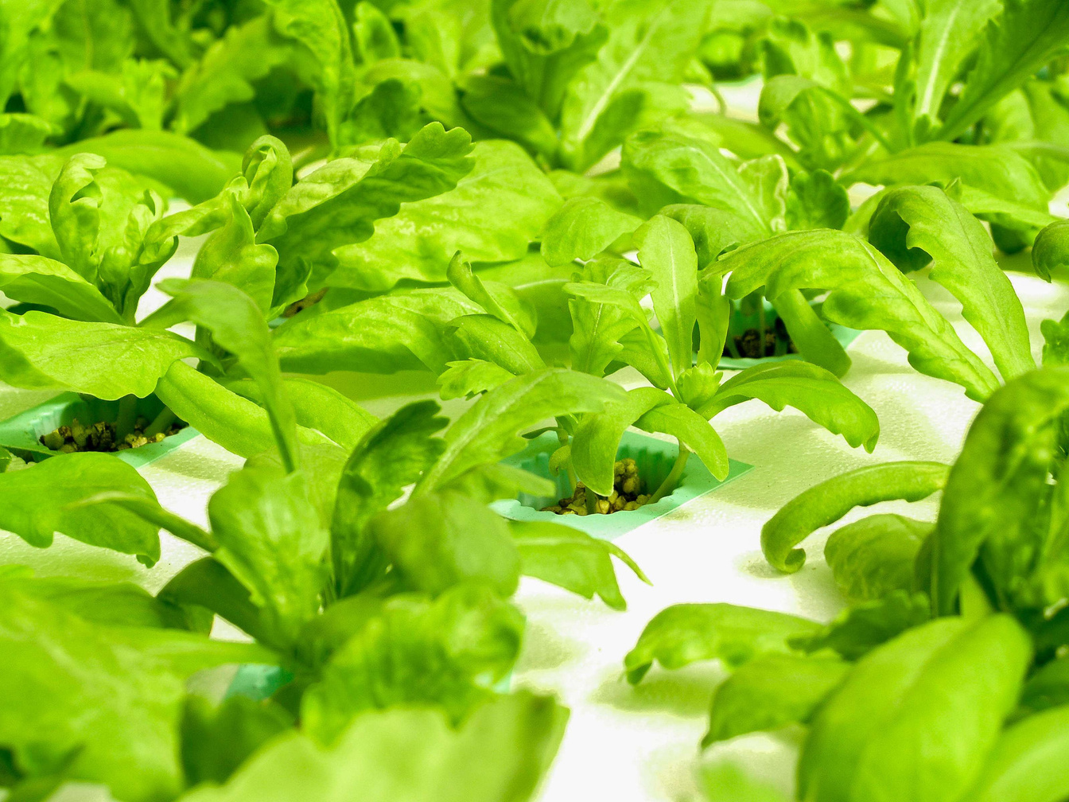
Limitation and future works
Limitation
Future Works
Data Quality and Availability:
Integration with IoT and Real-Time Data:
The performance of models depends on the quality and completeness of data, which might be inconsistent or limited in some regions, affecting the accuracy of predictions.
Future studies could explore integrating IoT sensors and real-time weather data to provide dynamic and location-specific crop recommendations, improving accuracy and adaptability.
Limited Generalization to Diverse Regions:
Incorporating Deep Learning and Advanced Models:
Models trained on data from specific regions may not generalize well to other areas with different climates, soil conditions, or agricultural practices, reducing their effectiveness in broader contexts.
Exploring the use of deep learning (e.g., CNNs or LSTMs) for feature extraction and prediction could capture complex relationships in the data that traditional machine learning models may miss.

Slide 19

Conclusion
Agriculture's Role: Crucial for food security, economic stability, and trade development.
Challenges: Traditional practices face issues like unstable climate and seasonal limitations.
Study Focus: Explores machine learning methods for predicting and analyzing crop recommendations.
XGBoost Classifier: Demonstrates how variations in soil and climate factors can optimize crop selection and improve sustainability.

Slide 20
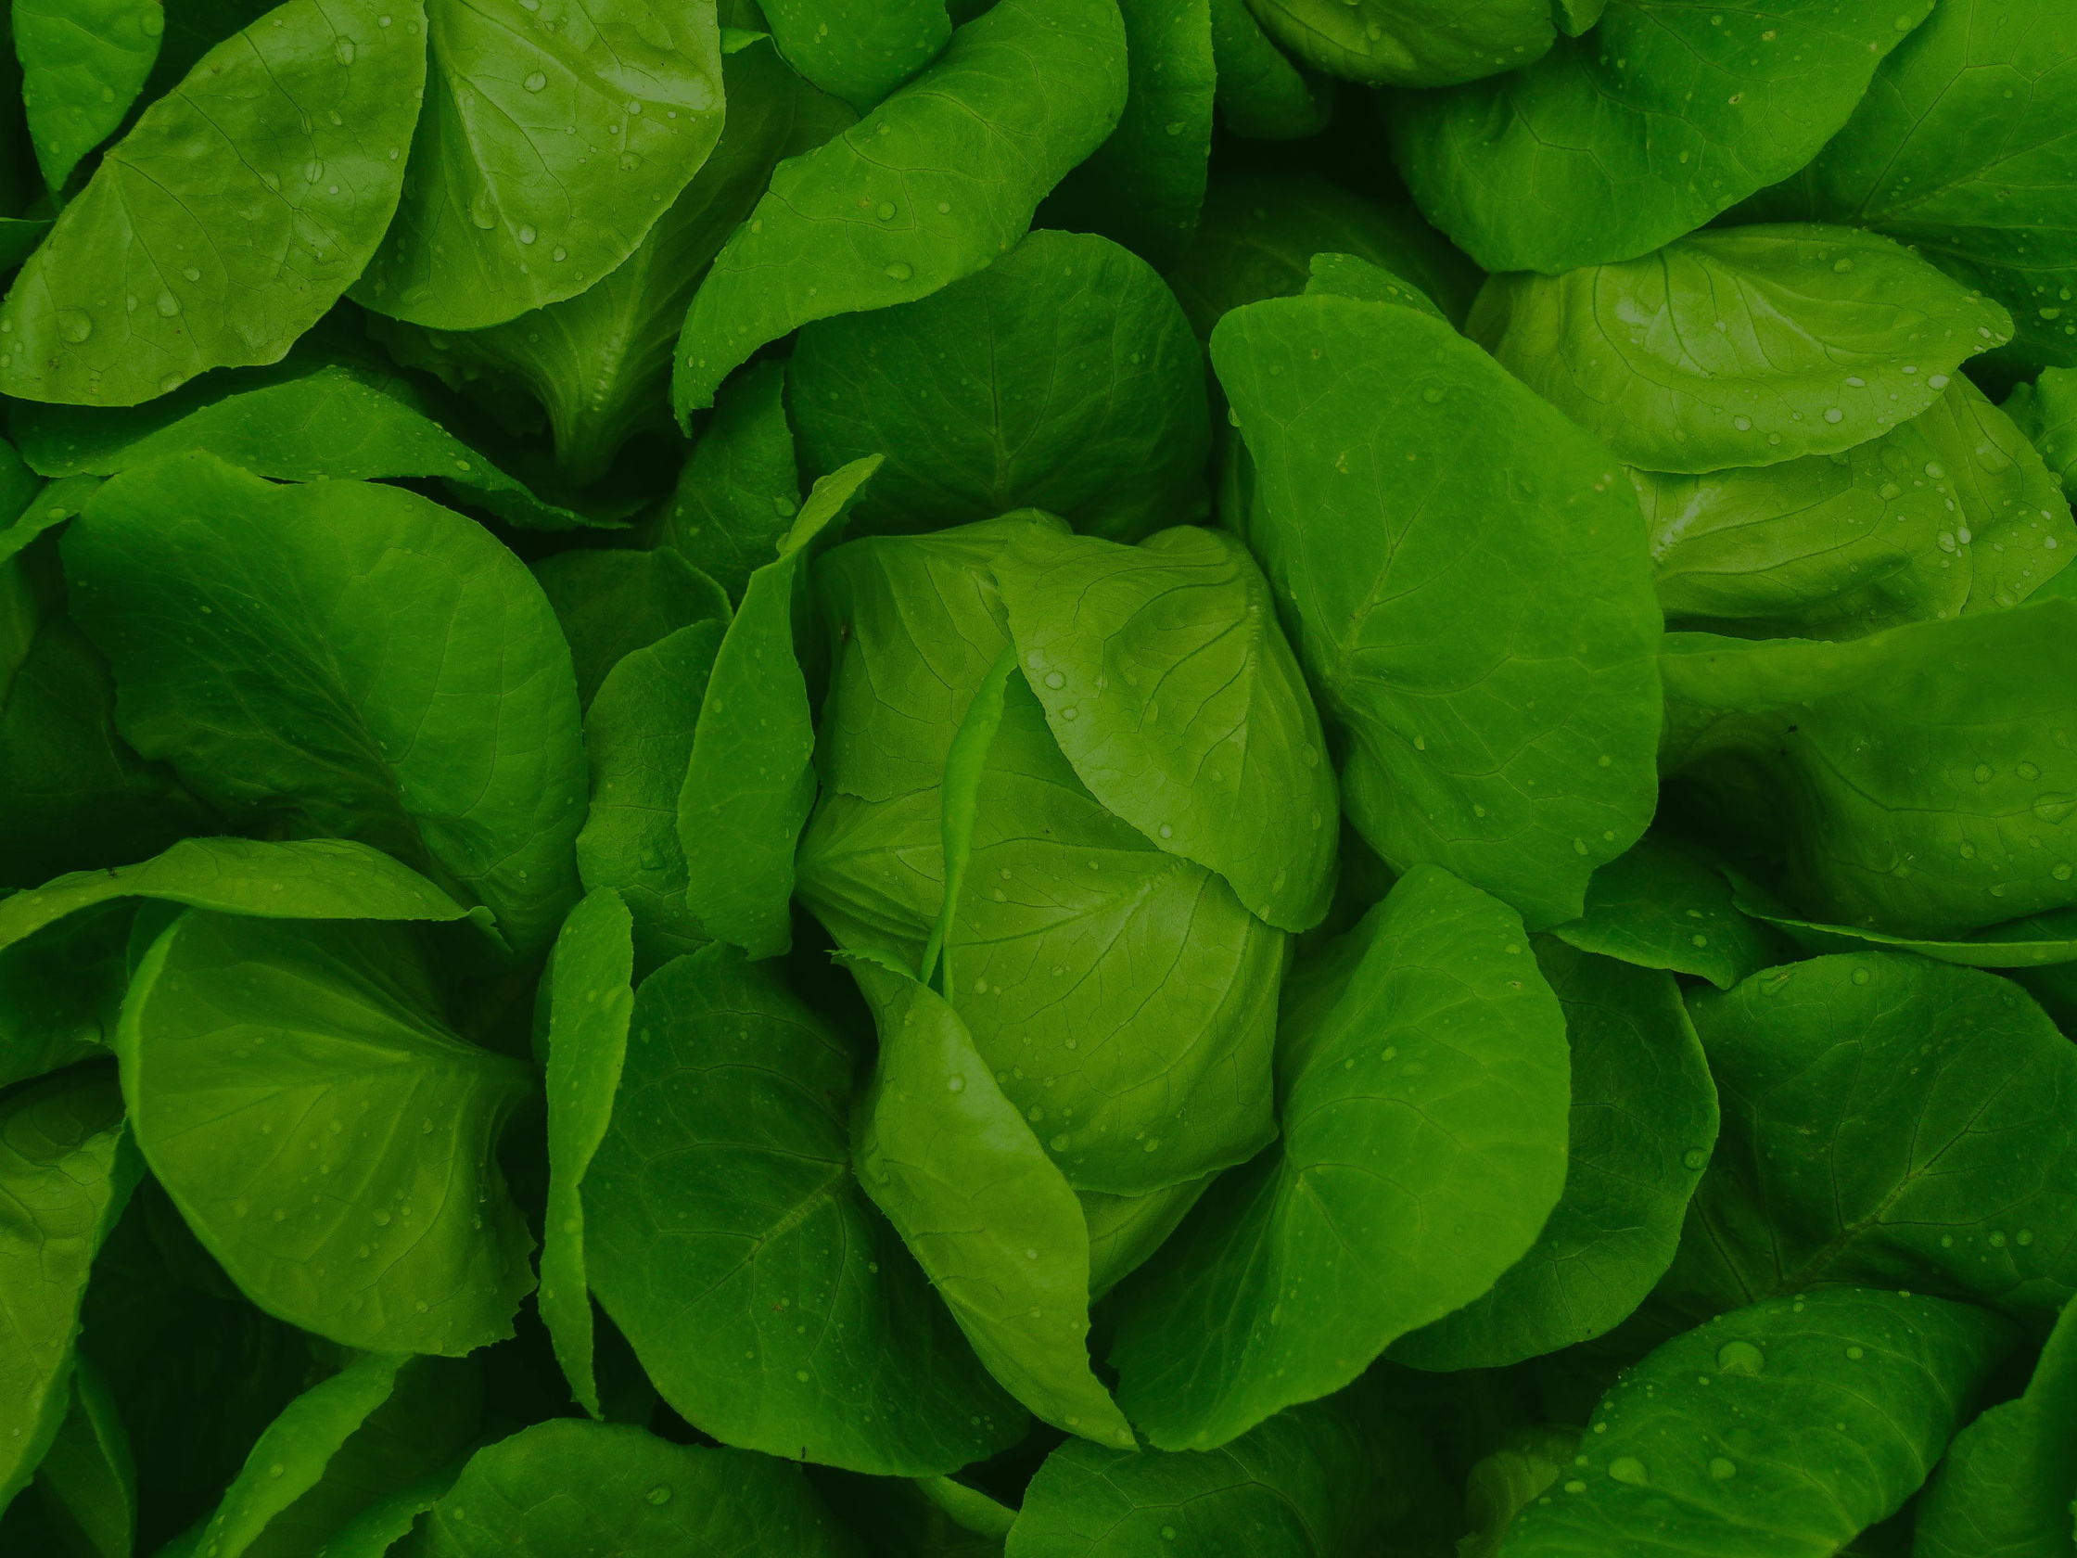
Thank You.

